Slide 1

MACHINE INTELLIGENCE
Dr. N MEHALA
Department of Computer Science and Engineering

Slide 2

MACHINE INTELLIGENCE
Module 4 [Unsupervised Learning]
Dr. N MEHALA
Department of Computer Science and Engineering

Slide 3
MACHINE INTELLIGENCE
Association Rule Mining
Given a set of transactions, find rules that will predict the occurrence of an item based on the occurrences of other items in the transaction
Market-Basket transactions
Example of Association Rules
{Diaper} → {Beer}, {Milk, Bread} → {Eggs,Coke}, {Beer, Bread} → {Milk},
Implication means co-occurrence, not causality!

Slide 4
MACHINE INTELLIGENCE
Association Rule Mining : Definition
Itemset
A collection of one or more items
Example: {Milk, Bread, Diaper}
k-itemset
An itemset that contains k items
Support count (σ)
Frequency of occurrence of an itemset
E.g. σ({Milk, Bread,Diaper}) = 2
Support
Fraction of transactions that contain an itemset
E.g. s({Milk, Bread, Diaper}) = 2/5
Frequent Itemset
An itemset whose support is greater than or equal to a minsup threshold

Slide 5
MACHINE INTELLIGENCE
Association Rule Mining : Definition
Association Rule
An implication expression of the form X → Y, where X and Y are itemsets
Example: {Milk, Diaper} → {Beer}
Rule Evaluation Metrics
Support (s): Fraction of transactions that contain both X and Y
Confidence (c): Measures how often items in Y appear in transactions that contain X
Example:

Slide 6
MACHINE INTELLIGENCE
Mining Association Rules
Two-step approach:
Frequent Itemset Generation
Generate all itemsets whose support ≥ minsup
Rule Generation
Generate high confidence rules from each frequent itemset, where each rule is a binary partitioning of a frequent itemset

Slide 7
MACHINE INTELLIGENCE
Mining Association Rules : Rule Generation
Given a frequent itemset L, find all non-empty subsets f ⊂ L such that f → L – f satisfies the minimum confidence requirement
If {A,B,C,D} is a frequent itemset, candidate rules:
ABC →D, ABD →C, ACD →B, BCD →A, A →BCD, B →ACD, C →ABD, D →ABC AB →CD, AC → BD, AD → BC, BC →AD, BD →AC, CD →AB,
If |L| = k, then there are 2^{k} – 2 candidate association rules (ignoring L → ∅ and ∅ → L)

Slide 8
MACHINE INTELLIGENCE
Rule Generation
How to efficiently generate rules from frequent itemsets?
In general, confidence does not have an anti-monotone property
c(ABC →D) can be larger or smaller than c(AB →D)
But confidence of rules generated from the same itemset has an anti-monotone property
e.g., L = {A,B,C,D}: c(ABC → D) ≥ c(AB → CD) ≥ c(A → BCD)
Confidence is anti-monotone w.r.t. number of items on the RHS of the rule

Slide 9
MACHINE INTELLIGENCE
Rule Generation for Apriori Algorithm
Pruned Rules

Slide 10
THANK YOU
Dr. N MEHALA
Department of Computer Science and Engineering
mehala@pes.edu

Slide 11
MACHINE INTELLIGENCE
Dr. N MEHALA
Department of Computer Science and Engineering

Slide 12
MACHINE INTELLIGENCE
Module 4 [Unsupervised Learning]
Dr. N MEHALA
Department of Computer Science and Engineering

Slide 13
MACHINE INTELLIGENCE
Association Rule Mining : Example
CONSIDER THE FOLLOWING DATASET WITH THE FOLLOWING INPUTS.
Minimum support (i.e coverage): 60%
Minimum confidence (i.e. accuracy): 80%
Trans_id Itemlist
T1 {K, A, D, B}
T2 {D, A C, E, B}
T3 {C, A, B, E}
T4 {B, A, D}
STEP 1: FREQUENT ITEMSET GENERATION
STEP2: RULE GENERATION

Slide 14
STEP 1: FREQUENT ITEMSET GENERATION
MACHINE INTELLIGENCE
Association Rule Mining : Example

Slide 15
MACHINE INTELLIGENCE
Association Rule Mining : Example
Minimum support (i.e coverage): 60%
Minimum confidence (i.e. accuracy): 80%
Trans_id Itemlist
T1 {K, A, D, B}
T2 {D, A C, E, B}
T3 {C, A, B, E}
T4 {B, A, D}
1-ItemSet | Support Count
{A} | 4
{B} | 4
{C} | 2
{D} | 3
{E} | 2
{K} | 1

Slide 16
MACHINE INTELLIGENCE
Association Rule Mining : Example
Now let's form the item sets containing 2 items.
1-ItemSet | Support Count
{A} | 4
{B} | 4
{D} | 3
1-ItemSet | Support Count
{A} | 4
{B} | 4
{C} | 2
{D} | 3
{E} | 2
{K} | 1
2-ItemSet | Support Count
{A, B} | 4
{B, D} | 3
{A, D} | 3

Slide 17
MACHINE INTELLIGENCE
Association Rule Mining : Example
STEP 3. The item sets containing 3 items. We only take the item sets from the previous phase whose support is 60% or more.
2-ItemSet | Support Count
{A, B} | 4
{B, D} | 3
{A, D} | 3
3-ItemSet | Support Count
{A, B, D} | 3

Slide 18
STEP2: Rule Generation
MACHINE INTELLIGENCE
Association Rule Mining : Example
Lets now form the rules and calculate their confidence (c). We only take the item sets from the previous phases whose support is 60% or more.
Minimum confidence (i.e. accuracy): 80%

Slide 19
Trans_id Itemlist
T1 {K, A, D, B}
T2 {D, A C, E, B}
T3 {C, A, B, E}
T4 {B, A, D}
MACHINE INTELLIGENCE
Association Rule Mining : Example
FREQUENT ITEM SETS
{A, B }
{A, D }
{B, D }
{A,B,D}
BINARY PARTITIONING:
A -> B
B -> A
A -> D
D -> A
B -> D
D -> B
AB -> D
D -> AB
AD -> B
B - > AD
BD -> A
A -> BD
A -> B P(B|A) = |B∩A| / |A| = 4/4, c: 100%
B -> A c: 100%
A -> D c: 75%

Slide 20
MACHINE INTELLIGENCE
Association Rule Mining : Example
A -> B P(B|A) = |B∩A| / |A| = 4/4, |c: 100%
B -> A c: 100%
A -> D c: 75%
D -> A c: 100%
B -> D c: 75%
D -> B c: 100%
AB -> D c: 75%
D -> AB c: 100%
AD -> B c: 100%
B - > AD c: 75%
BD -> A c: 100%
A -> BD c: 75%
The rules with a confidence measure of 75% are pruned, and we are left with the following rule set:
A -> B
B -> A
D -> A
D -> B
D -> AB
AD-> B
DB-> A
Minimum confidence (i.e. accuracy): 80%

Slide 21
MACHINE INTELLIGENCE
Association Rule Mining : Example 2

Slide 22
MACHINE INTELLIGENCE
Association Rule Mining : Example2
Student | Grade | Income | Buys
CS | High | Low | Milk
CS | High | High | Bread
Math | Low | Low | Bread
CS | Medium | High | Milk
Math | Low | Low | Bread

Slide 23
MACHINE INTELLIGENCE
Association Rule Mining : Example2
CONVERTED DATA
Student | Grade | Income | Buys
CS | High | Low | Milk
CS | High | High | Bread
Math | Low | Low | Bread
CS | Medium | High | Milk
Math | Low | Low | Bread
Student = CS (I1) | Student =math (I2) | Grade = high (I3) | Grade =medium (I4) | Grade =low (I5) | Income =high (I6) | Income =low (I7) | Buys=milk (I8) | Buys =bread (I9)
+ | - | + | - | - | - | + | + | -
+ | - | + | - | - | + | - | - | +
- | + | - | - | + | - | + | - | +
+ | - | - | + | - | + | - | + | -
- | + | - | - | + | - | + | - | +

Slide 24
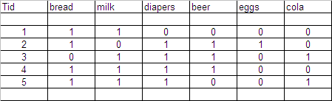
MACHINE INTELLIGENCE
Association Rule Mining
Market Basket data can be represented in binary form.
Bread, Milk, Diapers etc are binary variables.

Slide 25
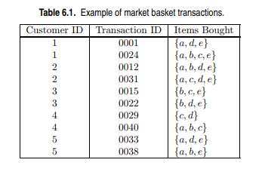
MACHINE INTELLIGENCE
Review of Support and Confidence
Compute the support for itemsets {e}, {b, d}, and {b, d, e} by treating each transaction ID as a market basket.
Use the results in part (a) to compute the confidence for the association rules {b, d} −→ {e} and {e} −→ {b, d}. Is confidence a symmetric measure?
Repeat part (a) by treating each customer ID as a market basket. Each item should be treated as a binary variable (1 if an item appears in at least one transaction bought by the customer, and 0 otherwise.)
(d) Use the results in part (c) to compute the confidence for the association rules {b, d} −→ {e} and {e} −→ {b, d}.
Q: What is the confidence for ф→А, А→ф?

Slide 26
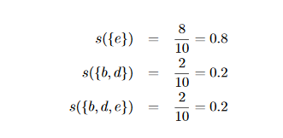
MACHINE INTELLIGENCE
Review of Support and Confidence
Compute the support for itemsets {e}, {b, d}, and {b, d, e} by treating each transaction ID as a market basket.
Q: What is the confidence for ф→А, А→ф?

Slide 27

MACHINE INTELLIGENCE
Review of Support and Confidence
Compute the support for itemsets {e}, {b, d}, and {b, d, e} by treating each transaction ID as a market basket.
Use the results in part (a) to compute the confidence for the association rules {b, d} −→ {e} and {e} −→ {b, d}. Is confidence a symmetric measure?
No, confidence is not a symmetric measure.
Q: What is the confidence for ф→А, А→ф?

Slide 28
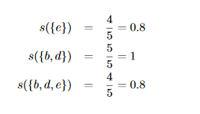
MACHINE INTELLIGENCE
Review of Support and Confidence
Repeat part (a) by treating each customer ID as a market basket. Each item should be treated as a binary variable (1 if an item appears in at least one transaction bought by the customer, and 0 otherwise.)
Q: What is the confidence for ф→А, А→ф?

Slide 29
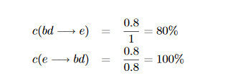
MACHINE INTELLIGENCE
Review of Support and Confidence
(d) Use the results in part (c) to compute the confidence for the association rules {b, d} −→ {e} and {e} −→ {b, d}.
Q: What is the confidence for ф→А, А→ф?

Slide 30
MACHINE INTELLIGENCE
Review of Support and Confidence
(d) Use the results in part (c) to compute the confidence for the association rules {b, d} −→ {e} and {e} −→ {b, d}.
Q: What is the confidence for {}→А, А→{}?
c({}→A)=s({}→A).
c(A→{}) = 100%.

Slide 31
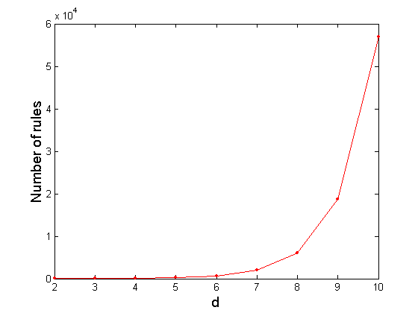
MACHINE INTELLIGENCE
Computational Complexity
Given d unique items:
Total number of itemsets = 2^{d}
Total number of possible association rules:
If d=6, R = 602 rules

Slide 32
MACHINE INTELLIGENCE
Summary
Association Rule Mining Task
Frequent Item Set Generation : Apriori Algorithm
Factors Affecting Complexity

Slide 33
MACHINE INTELLIGENCE
Resources
http://www2.ift.ulaval.ca/~chaib/IFT-4102-7025/public_html/Fichiers/Machine_Learning_in_Action.pdf
http://wwwusers.cs.umn.edu/~kumar/dmbook/.
ftp://ftp.aw.com/cseng/authors/tan
http://web.ccsu.edu/datamining/resources.html

Slide 34
THANK YOU
Dr. N MEHALA
Department of Computer Science and Engineering
mehala@pes.edu

